Slide 1
Year 7 Lesson 1 for Rhys and Patrick
The concurrent topics are Describing Chance and Best Buys.
Describing Chance is Exercises 8G, 8H, and 8I of Cambridge Second Edition.
Patrick, if you can’t find a set of Cambridge texts then take the set from Room 6.
There are almost no resources that Will and I could find for Best Buys so I have put together exercises for our students. I have just written this Powerpoint to make the activities more user-friendly. I will continue writing Powerpoints for the rest of the activities.
Delete this slide before using the Powerpoint in class.
Limit the Probability exercise to less than half of the lesson.
I have class sets of shopping brochures for all the students.
You will get a copy of the worksheet on Tuesday.

Slide 2
Title: PROBABILITY and BEST BUYS
AIMS
To be able to;
Describe how likely it is that an event will occur
Compare the price of similar items
PLAN
Describing Chance Exercise 8G, Q1-5 Cambridge text
Best Buys and Unit Pricing activity

Slide 3


What is probability?
likelihood or chance of
something happening
number of ways of getting what you want
number of possible outcomes

Slide 4
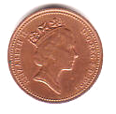
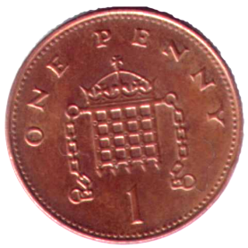
Example 1:
Tony tosses a coin. What is the
probability of getting a head?
number of ways of getting what you want
number of possible outcomes
1
2

Slide 5






Example 2:
Amy roll a fair dice, what is the
probability of getting a four?
number of ways of getting what you want
number of possible outcomes
1
6

Slide 6
How do we measure probability?

Slide 7
Probability scale
0
0.5
1
LIKELY
IMPOSSIBLE
CERTAIN
UNLIKELY
EVEN

Slide 8
Examples
Probability scale
0
0.5
1
IMPOSSIBLE
UNLIKELY
EVEN
LIKELY
CERTAIN

Slide 9
Individual practice
Exercise 8G, Q1-5 Cambridge text

Slide 10
BEST BUYS and
UNIT PRICING

Slide 11
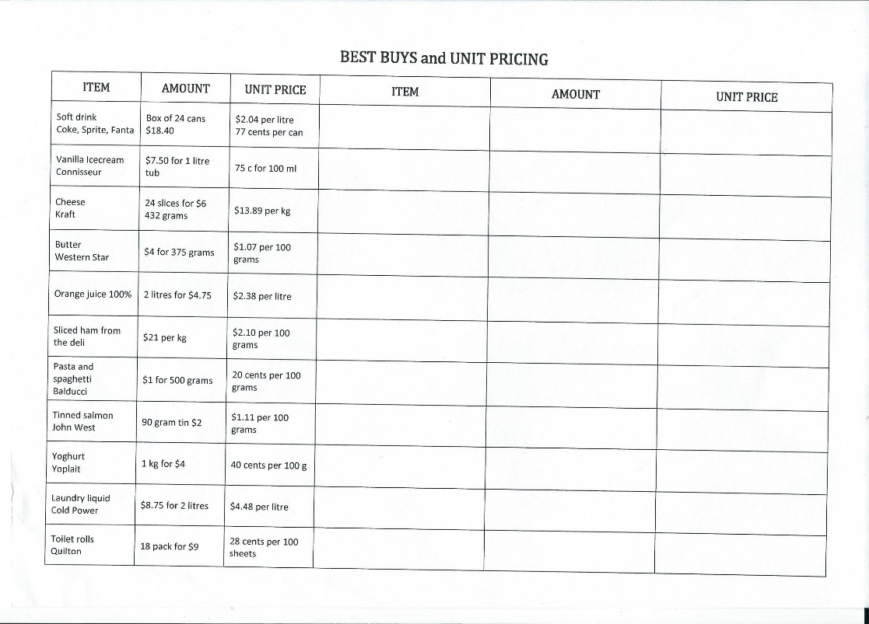
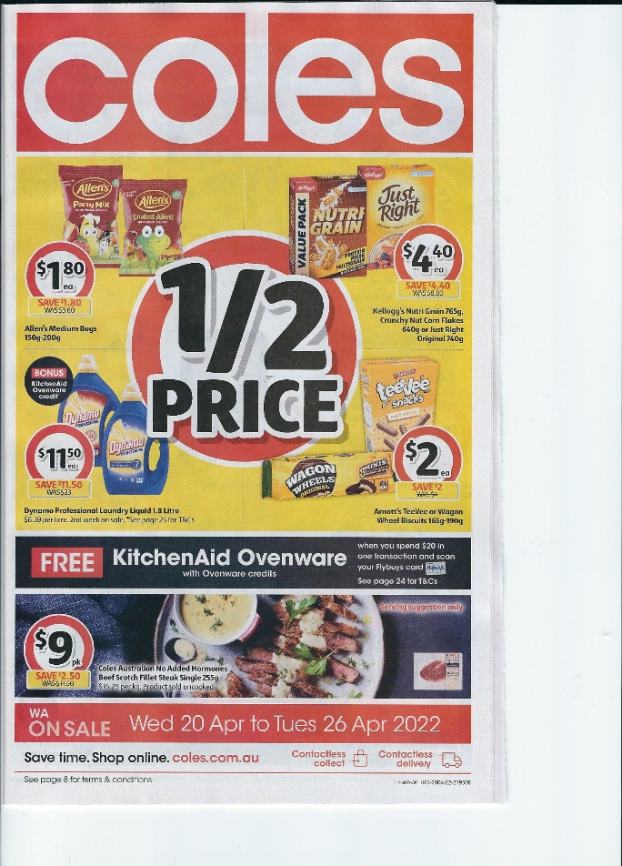
BEST BUYS and UNIT PRICING
Requirements for this task

Slide 12
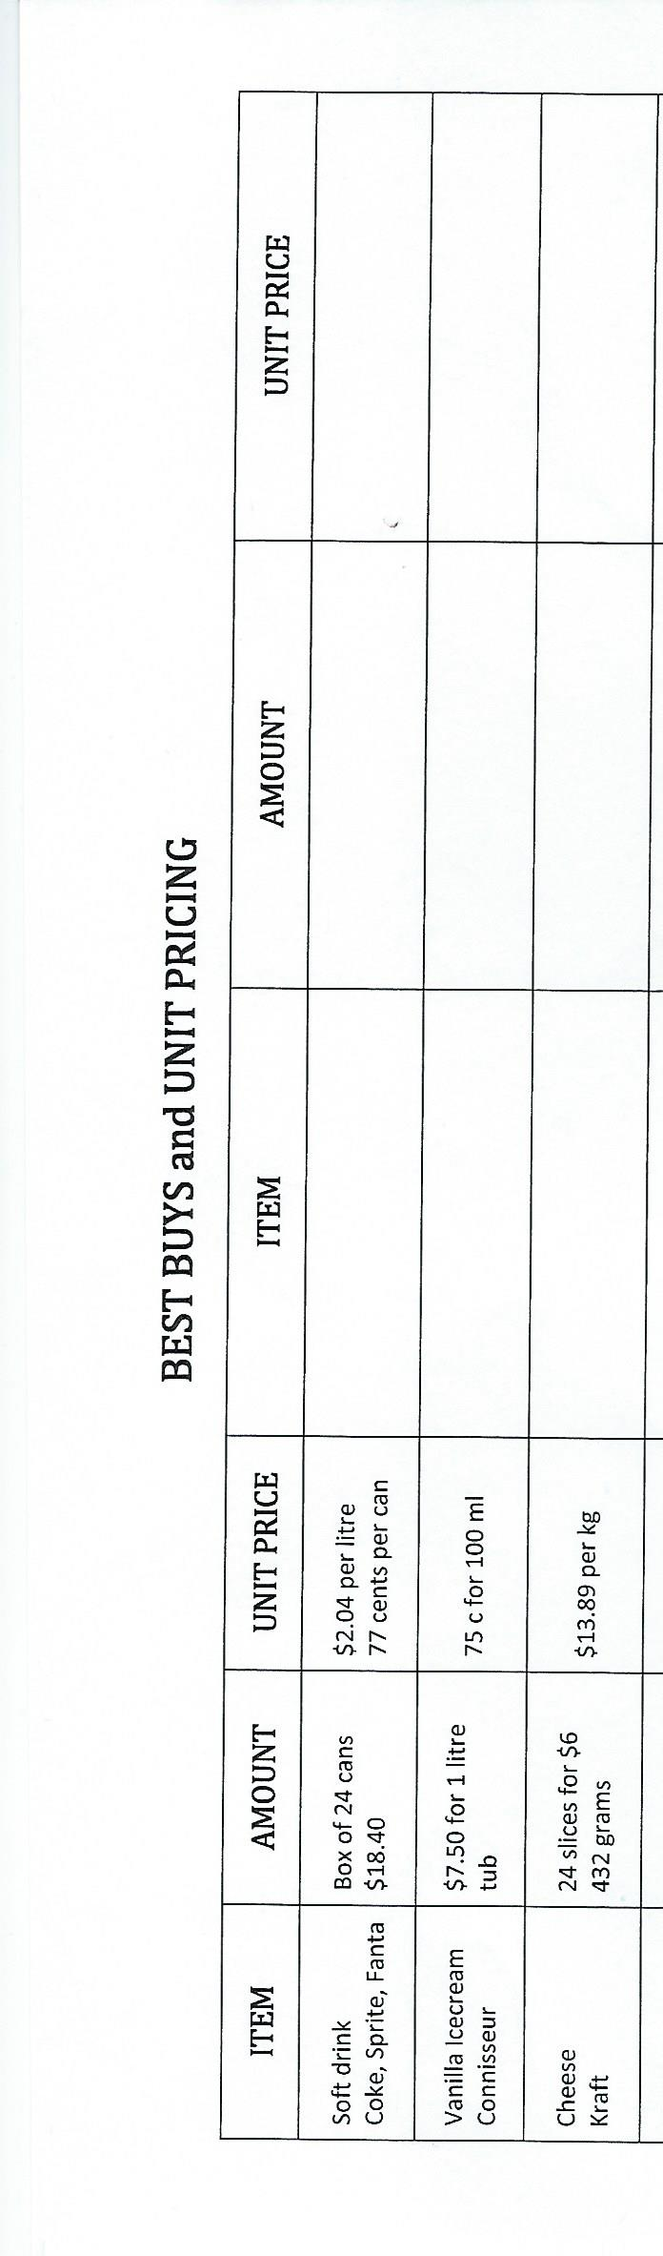
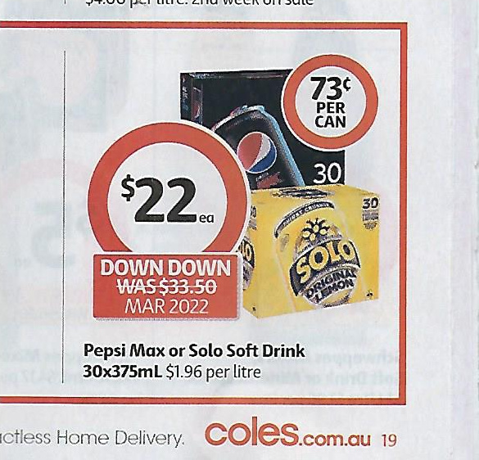
BEST BUYS and UNIT PRICING
Instructions
1. Find a similar item to the one in the table
eg: soft drink
Coke, Fanta, Sprite
2. Copy the details from the brochure onto the table
3. Compare the cost of the items. Which is cheaper?

Slide 13
BEST BUYS and UNIT PRICING
Instructions
1. Find a similar item to the one in the table
eg: soft drink
Coke, Fanta, Sprite
2. Copy the details from the brochure onto the table
3. Compare the cost of the items. Which is cheaper?
Pepsi Max and Solo, at 73 cents per can, compared to 77 cents per can for Coke, Fanta, Sprite

Slide 14
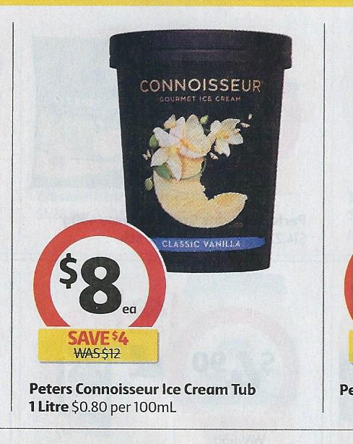
BEST BUYS and UNIT PRICING
Another example
1. Find a similar item to the one in the table
eg: Vanilla icecream Connisseur
2. Copy the details from the brochure onto the table
3. Compare the cost of the items. Which is cheaper; the 2021 or 2022 price for the same item?

Slide 15
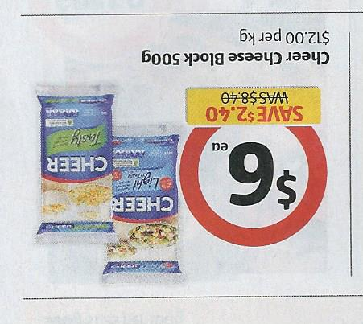
BEST BUYS and UNIT PRICING
A third example - cheese
1. What do you look for in the brochure?
2. Where do you copy the details?
3. How do the prices compare?
NOW CONTINUE THE EXERCISE

